Slide 1
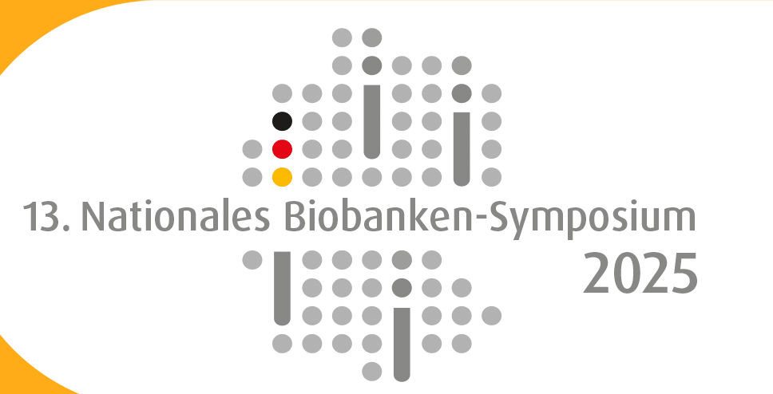

Biobanking Across Species and Environment
A national node perspective
Joséphine Uldry
Quality Officer at Swiss Biobanking Platform
Nationales Biobanken-Symposium 2025 in Berlin – 23.09.2025

Slide 2
Outline
SBP
Introduction
  — Swiss Biobanking Platform (SBP) Vision and Mission
  — SBP: a network of Human and Non-human biobanks
  — One Health: Basics
Challenges
  — Biobanking at the Human / Non-human interface
  — Legal & ethical -> Nagoya Protocol guideline
  — Interoperability -> Datasets and BIMS
Advancing non-human biobanking

Slide 3

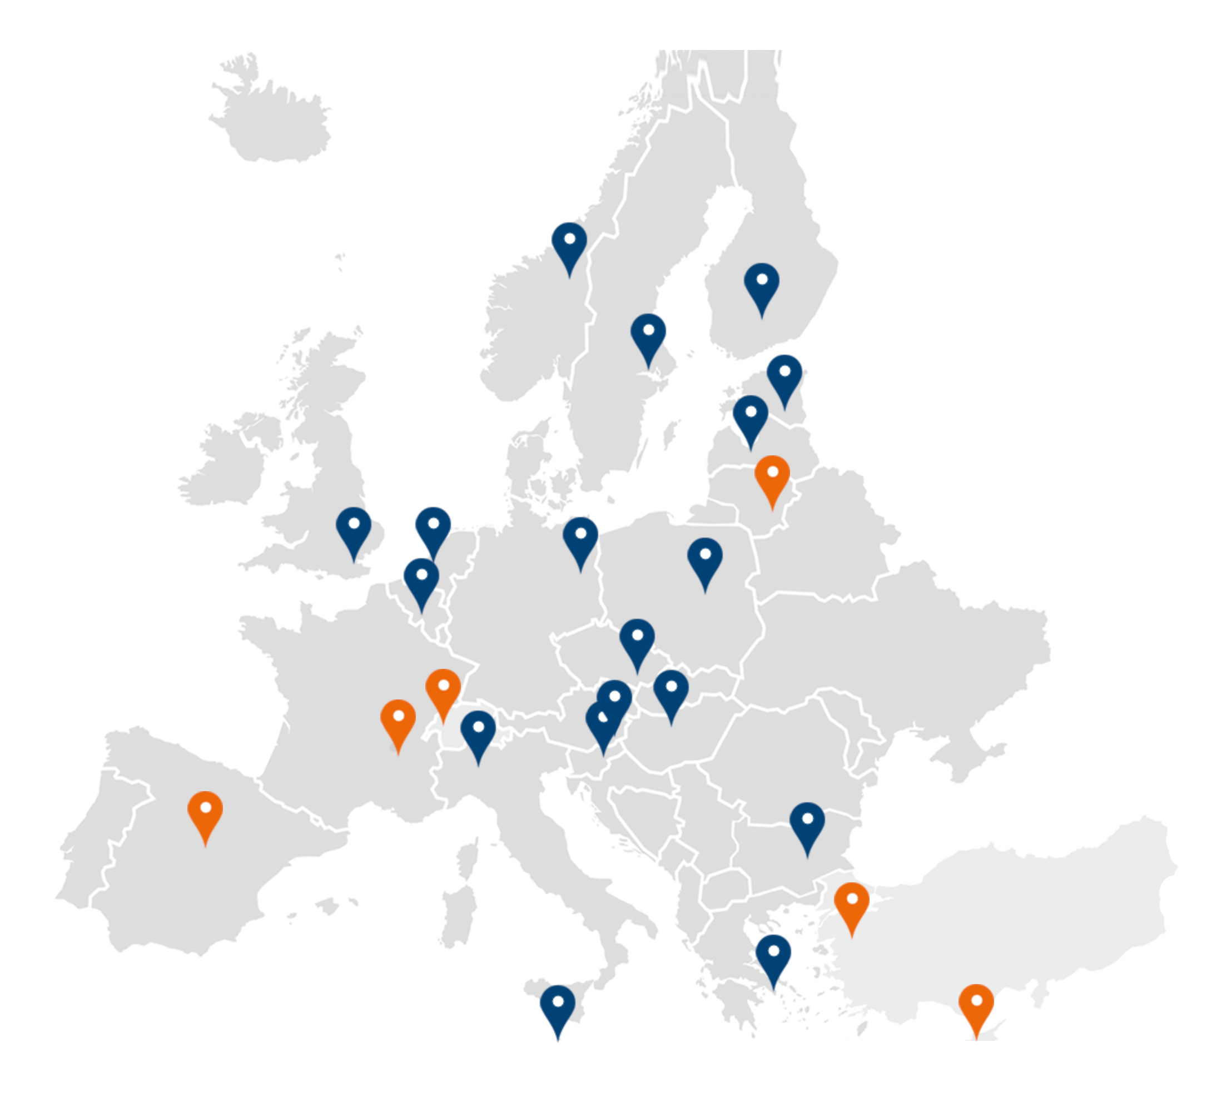
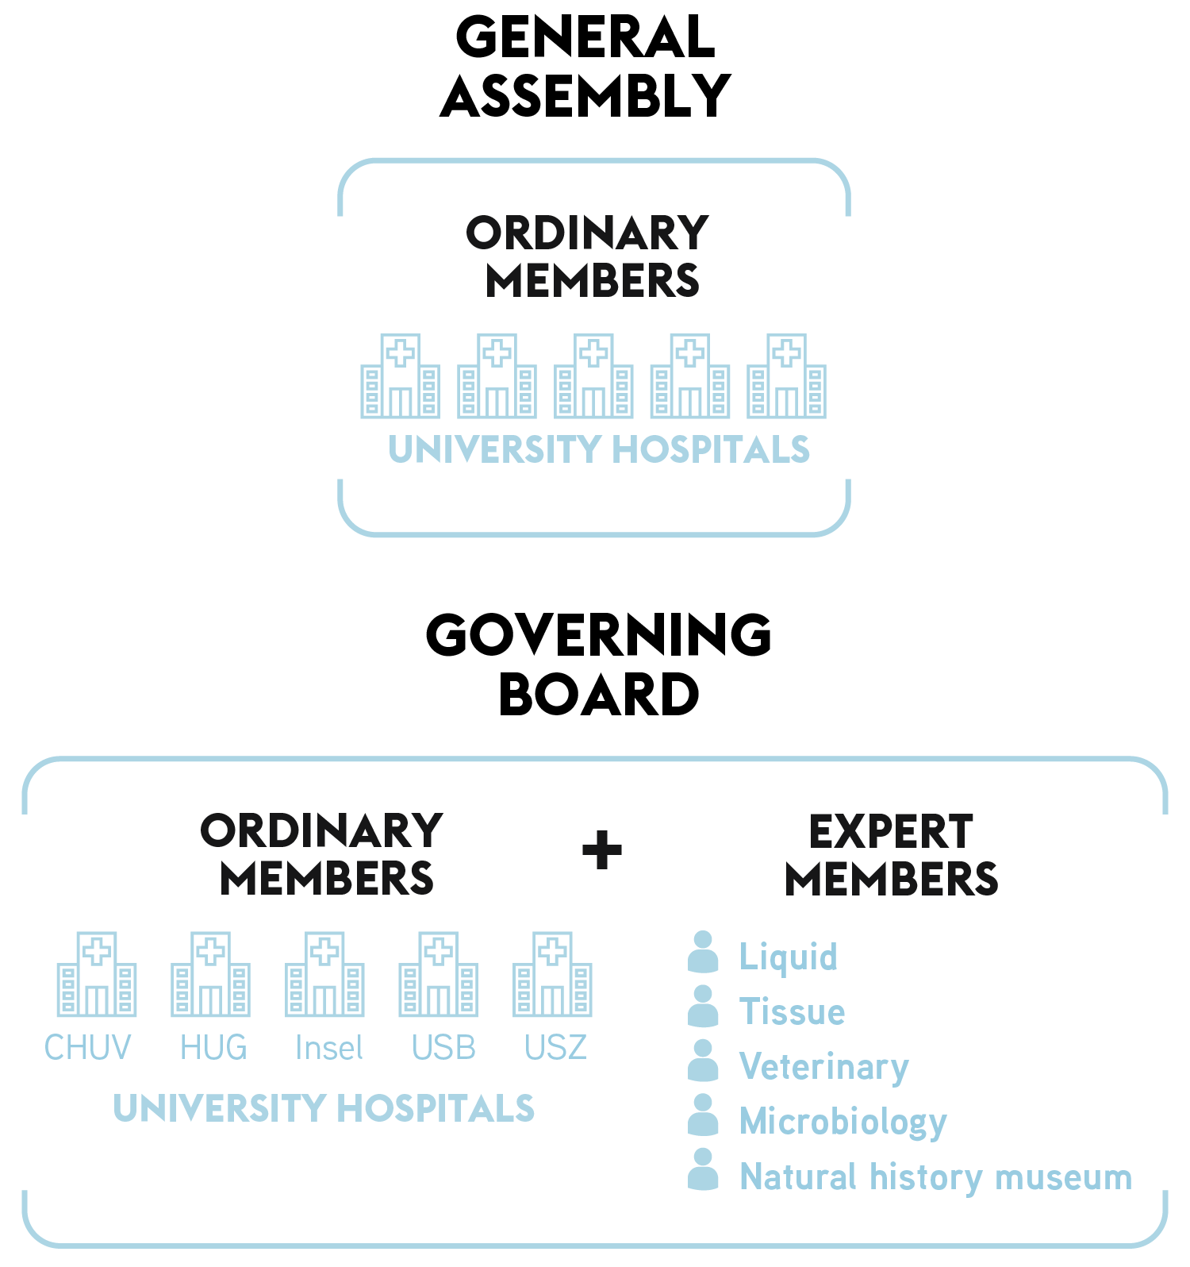
Vision and Mission
SBP is the research infrastructure of national importance supporting both human and non-human biobanking activities
SBP
Position CH at the forefront of research by facilitating access to and optimal usage of high-quality samples
Increase quality, visibility, accessibility and interoperability of biobanks
Independant association
mandated and funded by SNSF
GENERAL ASSEMBLY
ORDINARY
MEMBERS
BBMRI
national node

Slide 4
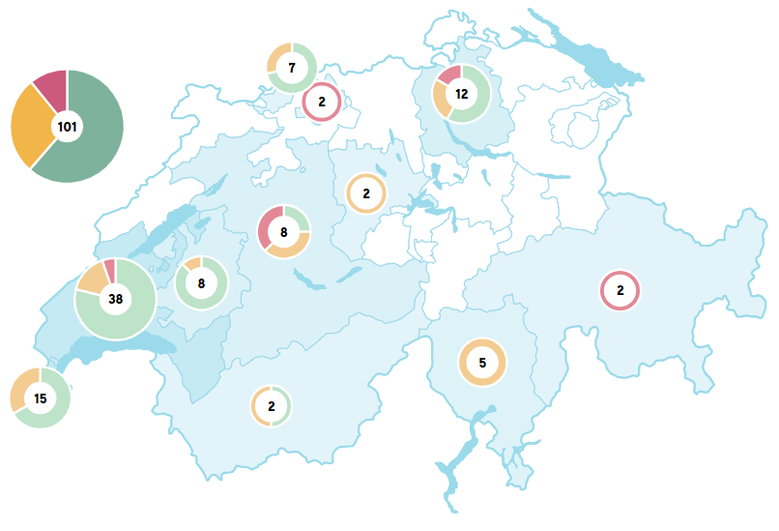

SBP Network
SBP
Human and non-human Biobanks adhering to high-quality standards and willing to share samples with researchers
Non-human engagement:
4 Microbiomes biobanks
2 Veterinary biobanks
7 Pathogens biobanks
1 Natural History Museum biobank coming soon
56
Directory
SBP Network data as of August 2025

Slide 5
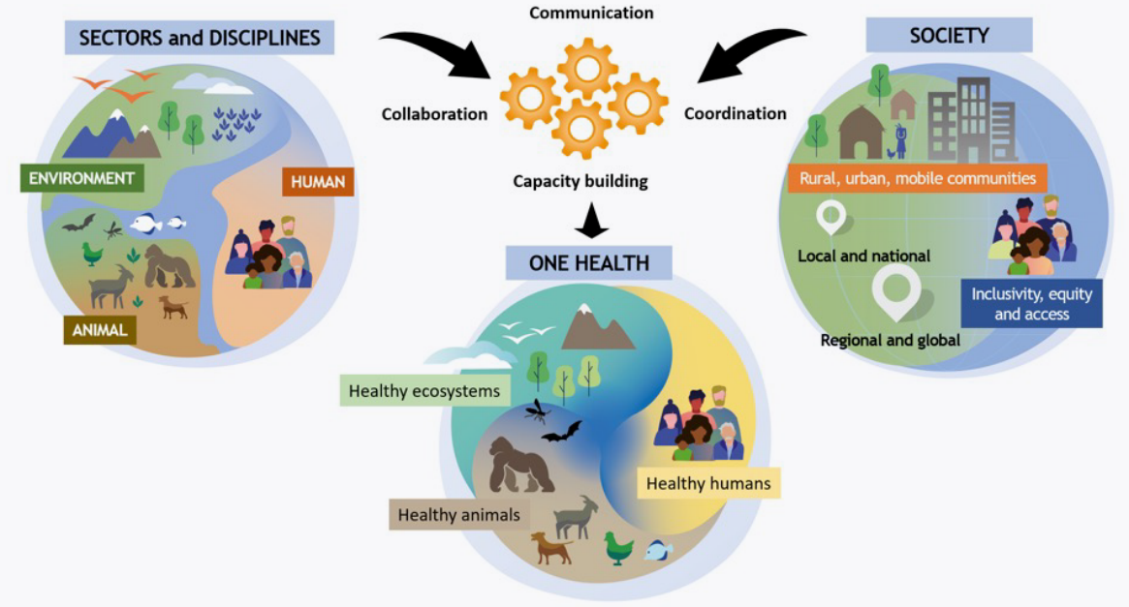
SBP
One Health: basics
“Balancing and optimizing the health of people, animals, and ecosystems, recognizing their close interconnection and interdependence” (World Health Organization)
Adapted from https://www.who.int/health-topics/one-health#tab=tab_1 , The “One Health” Approach. FAO, UNEP, WHO & WOAH. 2022 and https://doi.org/10.4060/cc2289en, Rome, FAO.

Slide 6
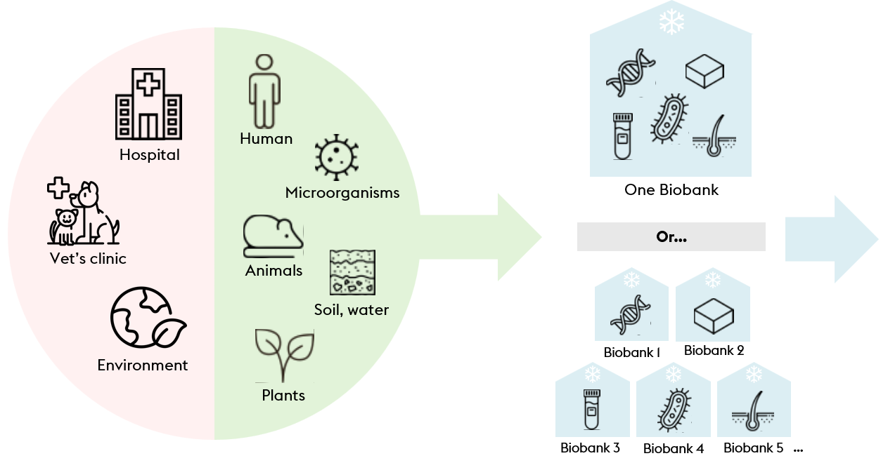

SBP
Challenges
Biobanking at the Human / Non-human interface
Researchers need access to standardized information on:
Preanalytics: collection, transport, processing, etc.
Medical data from participants
COLLECTION
TRANSPORT
PROCESSING / STORAGE
RETRIEVAL

Slide 7
SBP
Challenges
Biobanking at the Human / Non-human interface
Challenges
Distinct Ethics & Legal context
Interoperability
Researchers need access to standardized information on:
Preanalytics: collection, transport, processing, etc.
Medical data from participants
COLLECTION
TRANSPORT
PROCESSING / STORAGE
RETRIEVAL

Slide 8
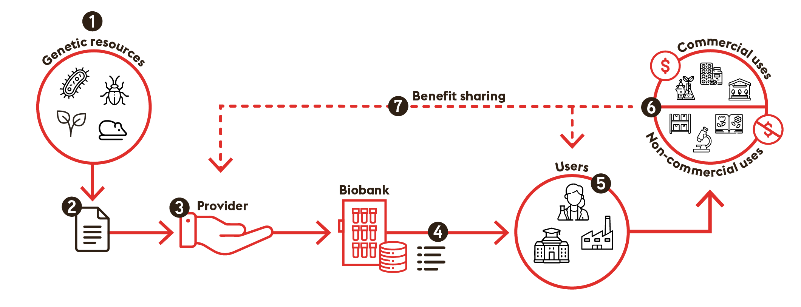
SBP guidance on Nagoya Protocol
ETHICAL & LEGAL: Example 1
Bilateral approach
Depending on the country:
Due diligence requirement
Prior Inform consent (PIC)
Mutually Agreed Terms (MAT)

Slide 9




Microbiota Vault Initiative biobank
ETHICAL & LEGAL: Example 1
Biobanking infrastructure in CH, as part of an international initiative aiming at preserving microbiomes from human, animal and environmental sources (One Health framework)
Prioritizes depositor sovereignty, equitable collaboration and ethical governance
Different local collections e.g. 5 human gut microbiome collections (from Brazil, Ethiopia, Laos, Ghana, Switzerland) and 3 collections of fermented food microbiomes (Ghana, Laos, Thailand).
Goal to transfer, store and sequence around 2000 samples from different countries.
Courtesy of Prof. Adrian Egli, University of Zurich (UZH), and Prof. Pascale Vonaesch. Adapted from Dominguez-Bello MG, et al., The microbiota vault initiative: safeguarding Earth's microbial heritage for future generations. Nat Commun. 2025 Jun 27;16(1):5373. doi: 10.1038/s41467-025-61008-5. PMID: 40579417; PMCID: PMC12205078.

Slide 10
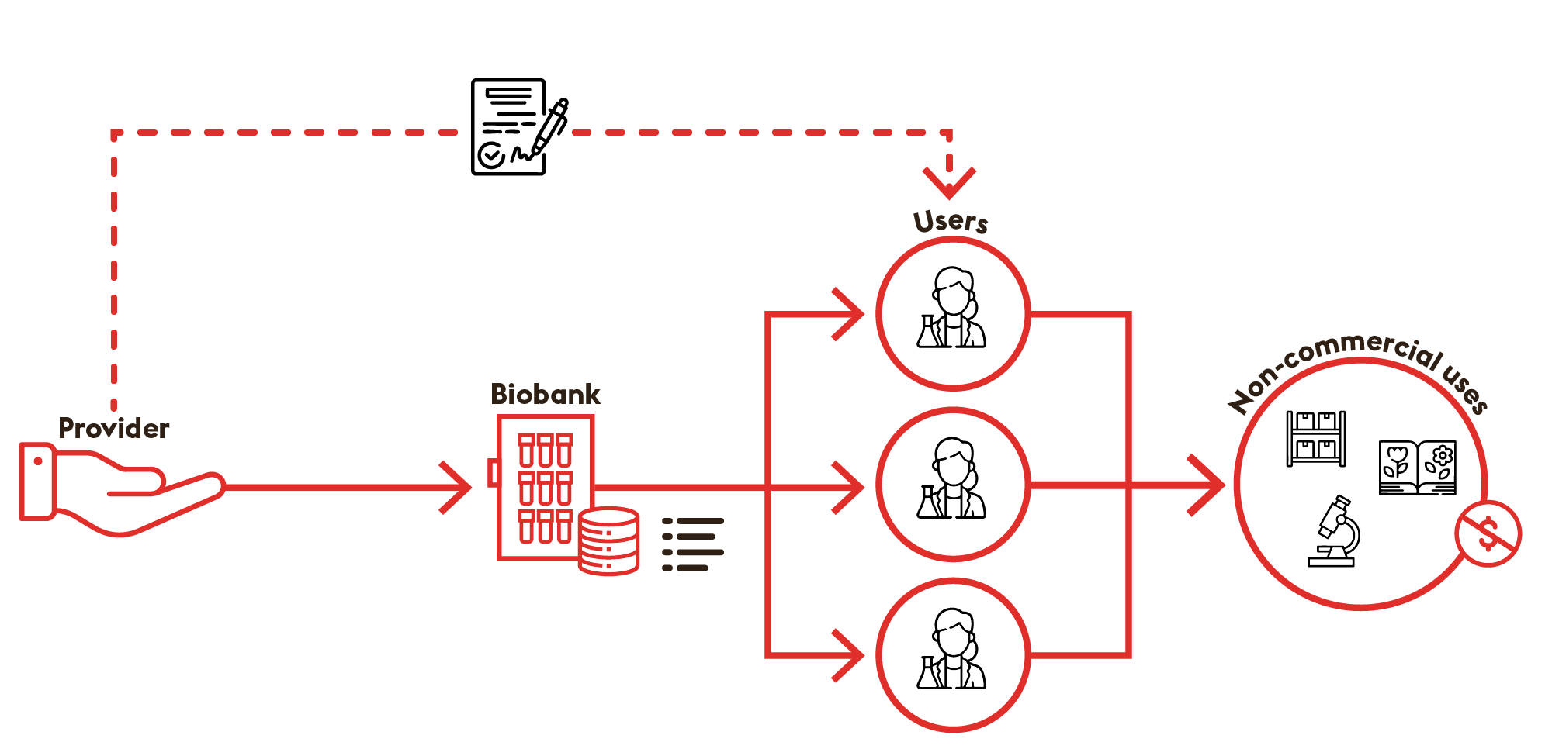
Nagoya Protocol in practice
ETHICAL & LEGAL: Example 1
Is a General waiver enough for non-commercial use ?
Several international countries
Smart move:
NN + international experts = better support for biobanks!

Slide 11




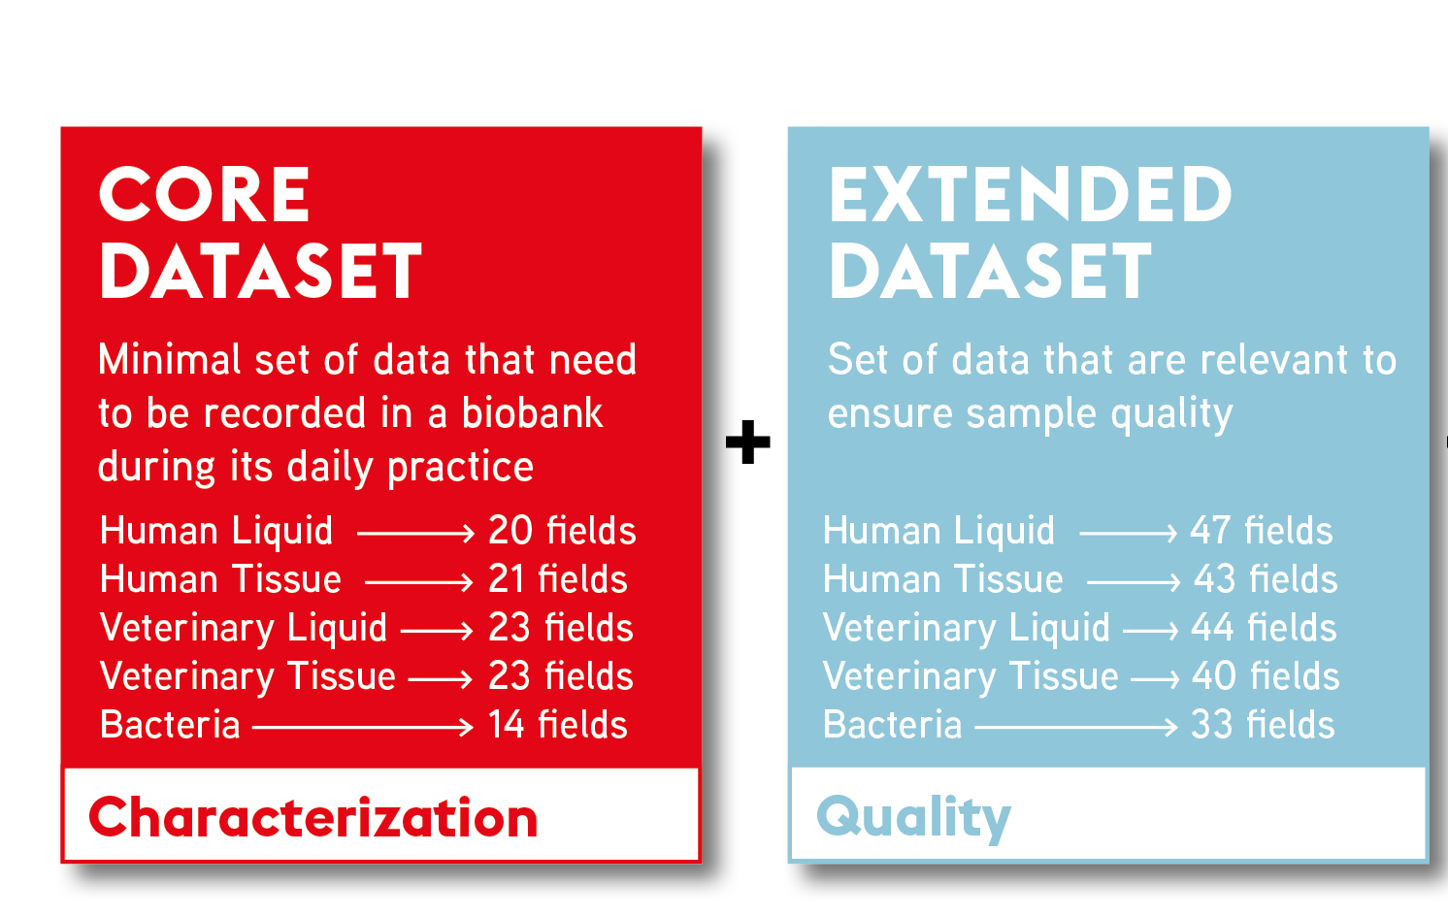


INTEROPERABILITY: Example 2
SBP BIMS – The package
The minimal data the biobank should document to ensure sample quality
Developed with SBP Working Groups and still evolving

Slide 12

Swiss Pathogen Surveillance Platform
INTEROPERABILITY: Example 2
Collaboration between Swiss microbiology biobanks from clinical labs
Focus on the molecular monitoring of microorganisms occurring in humans, animals and the environment
Secure online platform for the analysis and sharing of One health epidemiological and molecular data
Goals: Research and Surveillance of outbreaks and antimicrobial resistance at molecular level
Initial focus on Methicillin resistant Staphylococcus aureus (prototype), then proof of concept with SARS-CoV-2, now extend to other pathogens
Courtesy of Prof. Adrian Egli, University of Zurich (UZH), adapted from Neves A. et al., The Swiss Pathogen Surveillance Platform - towards a nation-wide One Health data exchange platform for bacterial, viral and fungal genomics and associated metadata. Microb Genom. 2023 May;9(5):mgen001001. doi: 10.1099/mgen.0.001001. PMID: 37171846; PMCID: PMC10272868.

Slide 13
Swiss Pathogen Surveillance Platform
INTEROPERABILITY: example 2
Typical Challenges for biobanks
  Access to diverse samples
  Human, animal, food, environment with geographic and phylogenetic data
  Ensure quality with well-characterized isolates Antibioresistance
  Standardized and interoperable data
SBP support
  SBP Bacteria datasets as baseline for metadata, SMPL BIMS / DiData, Preanalytical & quality guidelines, …
  GAP: often require more biobank and project-specific developments
  e.g. sequencing datasets, specific workflows
Smart move:
NN + pilot BB working hand in hand on the development of tools that could then serve the whole community
Courtesy of Prof. Adrian Egli, University of Zurich (UZH), adapted from Egli A. et al., Improving the quality and workflow of bacterial genome sequencing and analysis: paving the way for a Switzerland-wide molecular epidemiological surveillance platform. Swiss Med Wkly. 2018 Dec 15;148:w14693. doi: 10.4414/smw.2018.14693. PMID: 30552858.

Slide 14
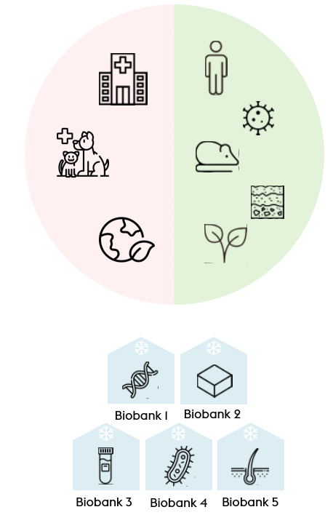
Advancing One Health biobanking
SBP
Stay close to the real needs on the ground
Start small (e.g: datasets) -> grow into advanced tools (e.g: BIMS)
Build trust with quick wins -> expand step by step:
  Integration: Gradually include diverse non-human biobanks into SBP network to address their specific needs and gain expertise
  Knowledge transfer: Apply lessons from human biobanking (quality, interoperability)
  Strengthen partnerships with expert hubs & European infrastructures (in coordination with BBMRI-ERIC)
  E.g: Experts from German Nagoya Protocol HuB
Leverage the SBP network to foster synergies across human and non-human biobanks

Slide 15

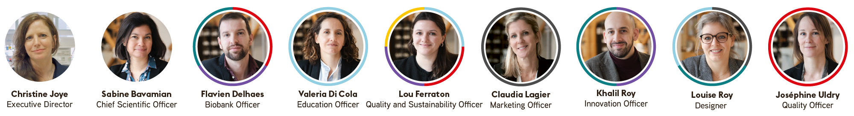
WWW.SWISSBIOBANKING.CH
Thank you!
… and special thanks to
Prof. Adrian Egli from University of Zurich
Prof. Pascale Vonaesch from University of Lausanne
Joséphine Uldry
Quality Officer
josephine.uldry@swissbiobanking.ch

